Slide 1

Climate Smart Communities
Dazzle Ekblad (DEC)
Amy Wyant (MVEDD, NYSERDA Clean Energy Communities Coordinator)
January 29, 2020

Slide 2
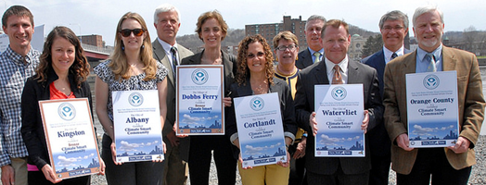
State Support for Local Climate Action
Assistance to local gov’t leaders for:
  Reduce greenhouse emissions
  Build resiliency in the face of climate change
Voluntary. No fees. Sponsored by 6 state agencies.
Comprehensive. Flexible.
Notes:
Flexible so can meet local priorities.

Slide 3

Climate Smart Pledge Elements
Build a Climate Smart Community
Inventory Emissions, Set Goals, & Plan for Climate Action
Decrease Energy Use
Shift to Clean, Renewable Energy
Use Climate-smart Materials Management
Implement Climate-Smart Land Use
Enhance Community Resilience to Climate Change
Support a Green Innovation Economy
Inform & Inspire the Public
Engage in an Evolving Process of Climate Action
Notes:
These are the core principles of the program. Pass a resolution with these 10 elements to join the programs.
Comprehensive. But flexible so can meet local priorities.

Slide 4
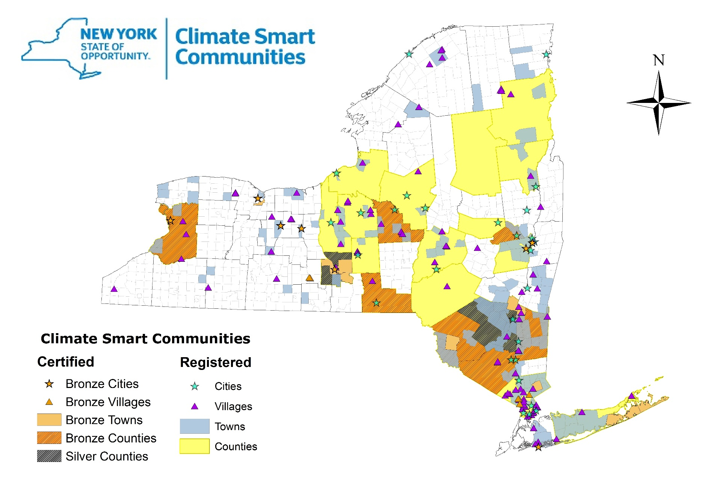
  291 Registered since 2009
    8.8 million people
    45% of NYS population
  37 Certified since 2014
    Leaders who have documented progress
    1,184 certification actions completed
  List at https://climatesmart.ny.gov/actions-certification/participating-communities/
Notes:
Two levels of participation
Program has expanded over time.

Slide 5
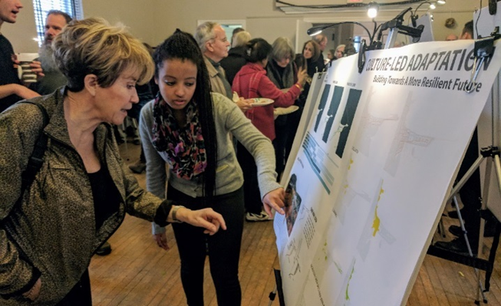
Benefits of CSC
  Free technical assistance
    Regional Coordinators
    Email list, website, workshops, tools/templates
  Networking: Learn with like-minded community leaders, shift culture
  Leadership recognition: State-level attention for local leaders
  Certification program: framework for local action, planning, priorities
  Funding: CSC grants; ZEV rebates; and helps in competing for other state $

Slide 6
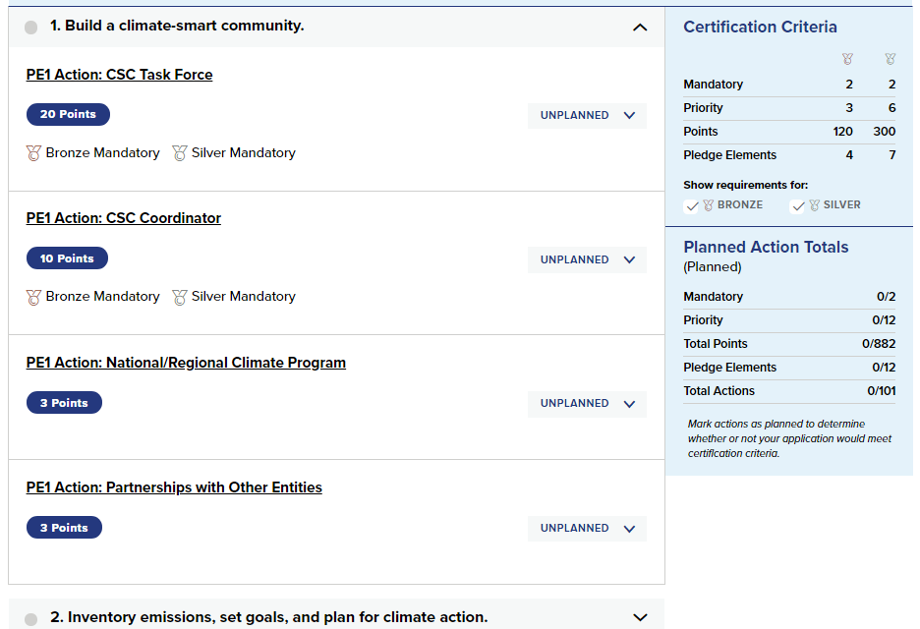
CSC Portal: https://climatesmart.ny.gov
Platform for participating in the certification program
List of recommended actions with info on related sources of funding and examples.
Participating Communities page: doc submitted by certified communities

Slide 7
How are CSC & CEC related?
Climate Smart Communities Certification
Comprehensive climate action program
100+ unique actions
Improve score on CSC grant applications
Clean Energy Communities (NYSERDA)
Focused on energy use
10 high-impact actions
  1 of 10 is becoming a Certified CSC
Complete 4 actions to access CEC grants
CSC Certification
Advanced Climate Actions
CEC Designation
Cost-saving Energy Actions
Earn points toward CSC certification by doing CEC actions
  Do both!

Slide 8
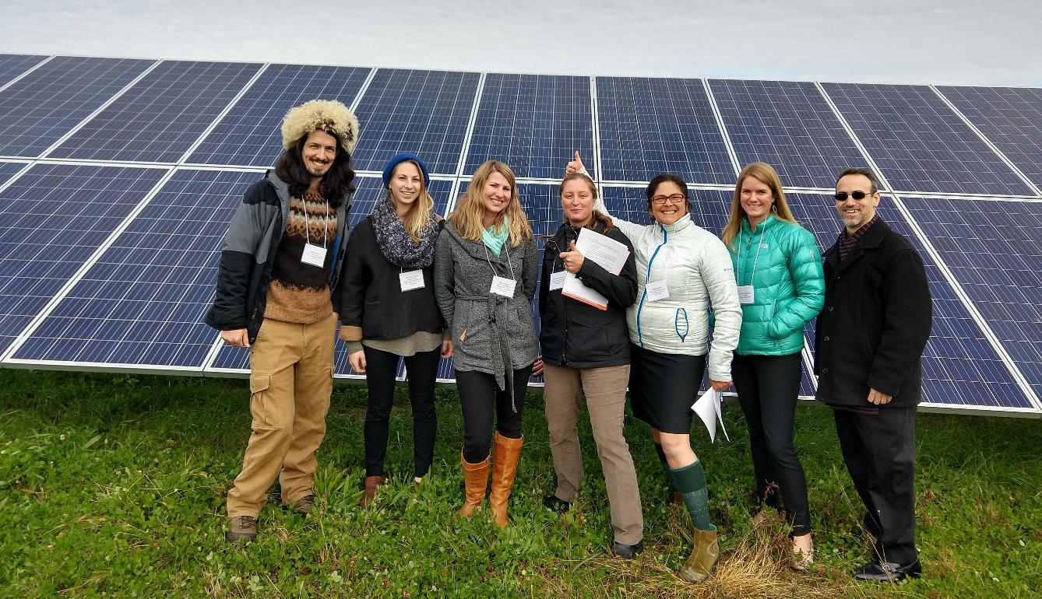
CEC Regional Coordinators
NYSERDA’s Clean Energy Communities Program (CEC)
  Free technical assistance to local governments
  Amy Wyant
  awyant@mvedd.org
  315-867-7882
  Mohawk Valley Clean Energy Community Coordinator
Notes:
Important to coordinate with these folks!

Slide 9
Thank You!
CSC Certification Portal: https://climatesmart.ny.gov
CSC Funding Programs: http://www.dec.ny.gov/energy/109181.html
CSC Webinar slides & recordings: http://www.dec.ny.gov/energy/84359.html
  Office of Climate Change
  NYS DEC
  625 Broadway, Albany NY 12233
  climatesmart@dec.ny.gov
  CSCgrants@dec.ny.gov
  ZEVrebate@dec.ny.gov
  518-402-8448

